Slide 1
Spatio-temporal modelling for
global sea level change
Zhe Sha, Maike Schumancher, William Llovel, Jonathan Rougier and Jonathan Bamber
University of Bristol, UK
[Sub-heading 1 e.g. Introduction]
[Body text]
[Sub-heading 3 e.g. Method]
[Body text]
[Sub-heading 4 e.g. Results]
[Body text]
[Sub-heading 5 e.g. Discussion]
[Body text]
[Sub-heading 2 e.g. Aims]
[Body text]

Slide 2
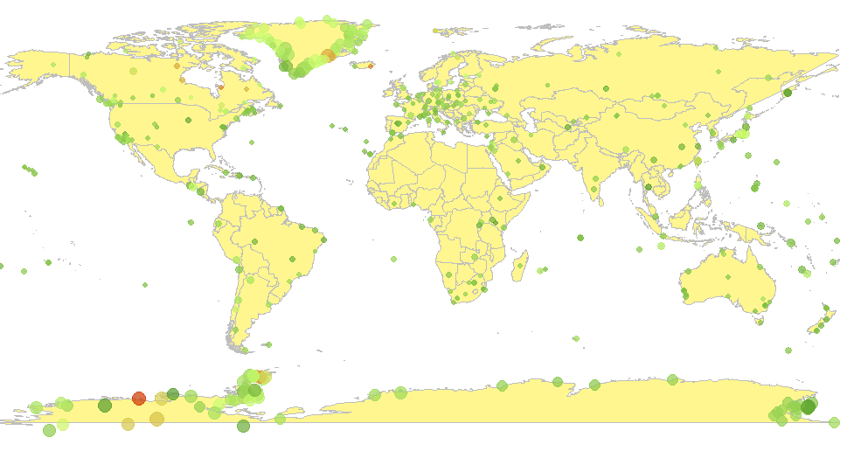
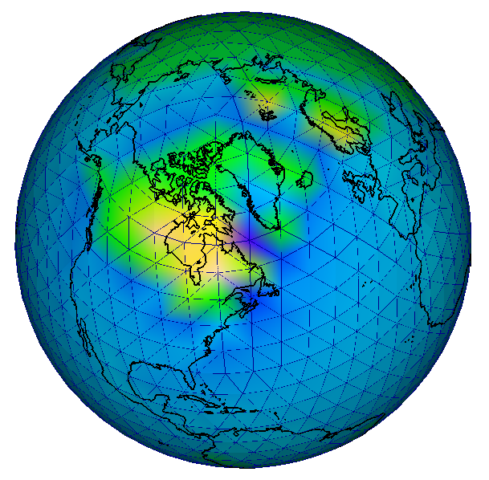
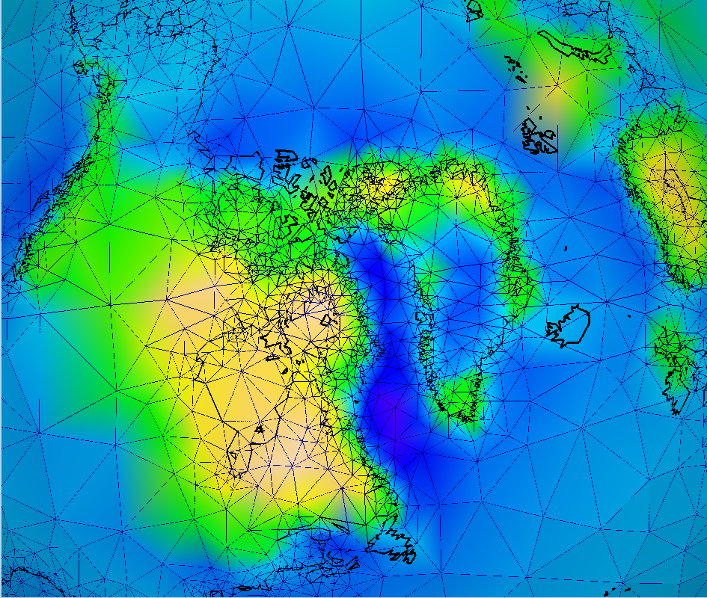
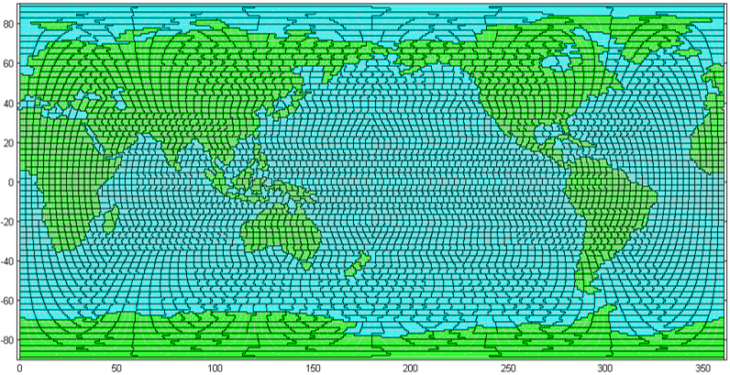

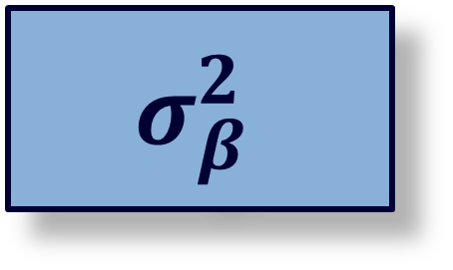


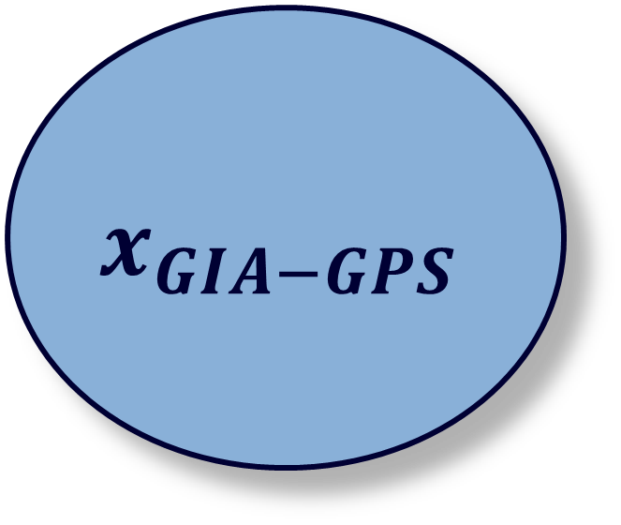




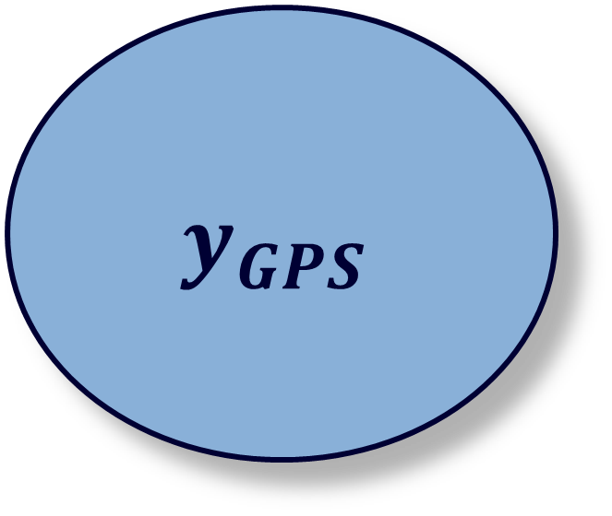
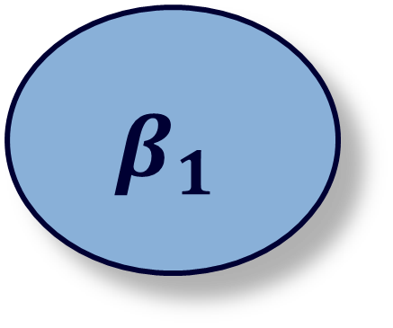

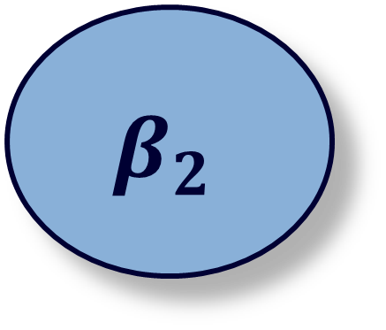

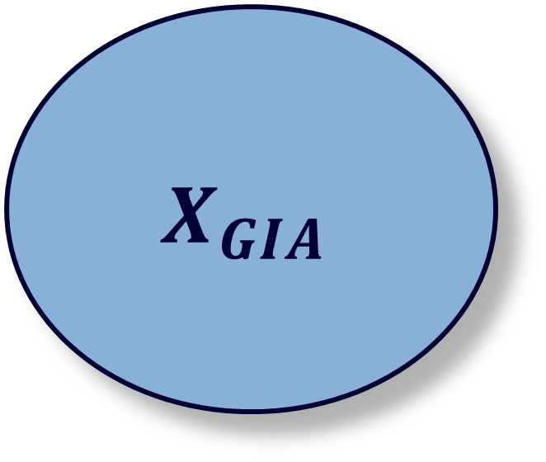


Global GPS Data – point observations
A semi-regular mesh for GIA
$$μ_{θ}$$
$$Σ_{GPS}$$
$$𝓐_{GPS}$$
$$θ$$
$$σ_{θ}^{2}$$
$$β_{1}$$
$$y_{GPS}$$
$$x_{GIA−GPS}$$
$$X_{GIA}$$
$$σ_{β}^{2}$$
$$μ_{β}$$
Spatial resolution of Gravity Recovery And Climate Experiment (GRACE)
$$y_{GRACE}$$
$$x_{GIA−GRACE}$$
$$β_{2}$$
$$μ_{GIA}$$
$$Σ_{GRACE}$$
$$𝓐_{GRACE}$$
The data are aggregated over approx. 3°x3° grid cells with long range error correlation.
An adaptive mesh for GIA

